Slide 1
Jens Evans and Sarah Mehler Sonar Final Project
PSU ECE 435/535 Winter 2020

Slide 2
Features and Implementation
Minimum Req’s:
Generate Pulse Train
Play Pulse Train through a speaker
Record the pulse train using the Matrix Board
Gate the recording for SNR gain
Find the Time Difference of Arrival between the send pulse and return
Estimate the distance to a single target
Estimate the distance with two targets
Envelope Detection / Estimation
Bonus Req’s:
Cross Correlation (Matched Filter)
FM Chirp
Three targets succesfully detected and displayed with peaks using a 40 meter setup
Implemented a parabolic focus for greater return gain and directionality

Slide 3
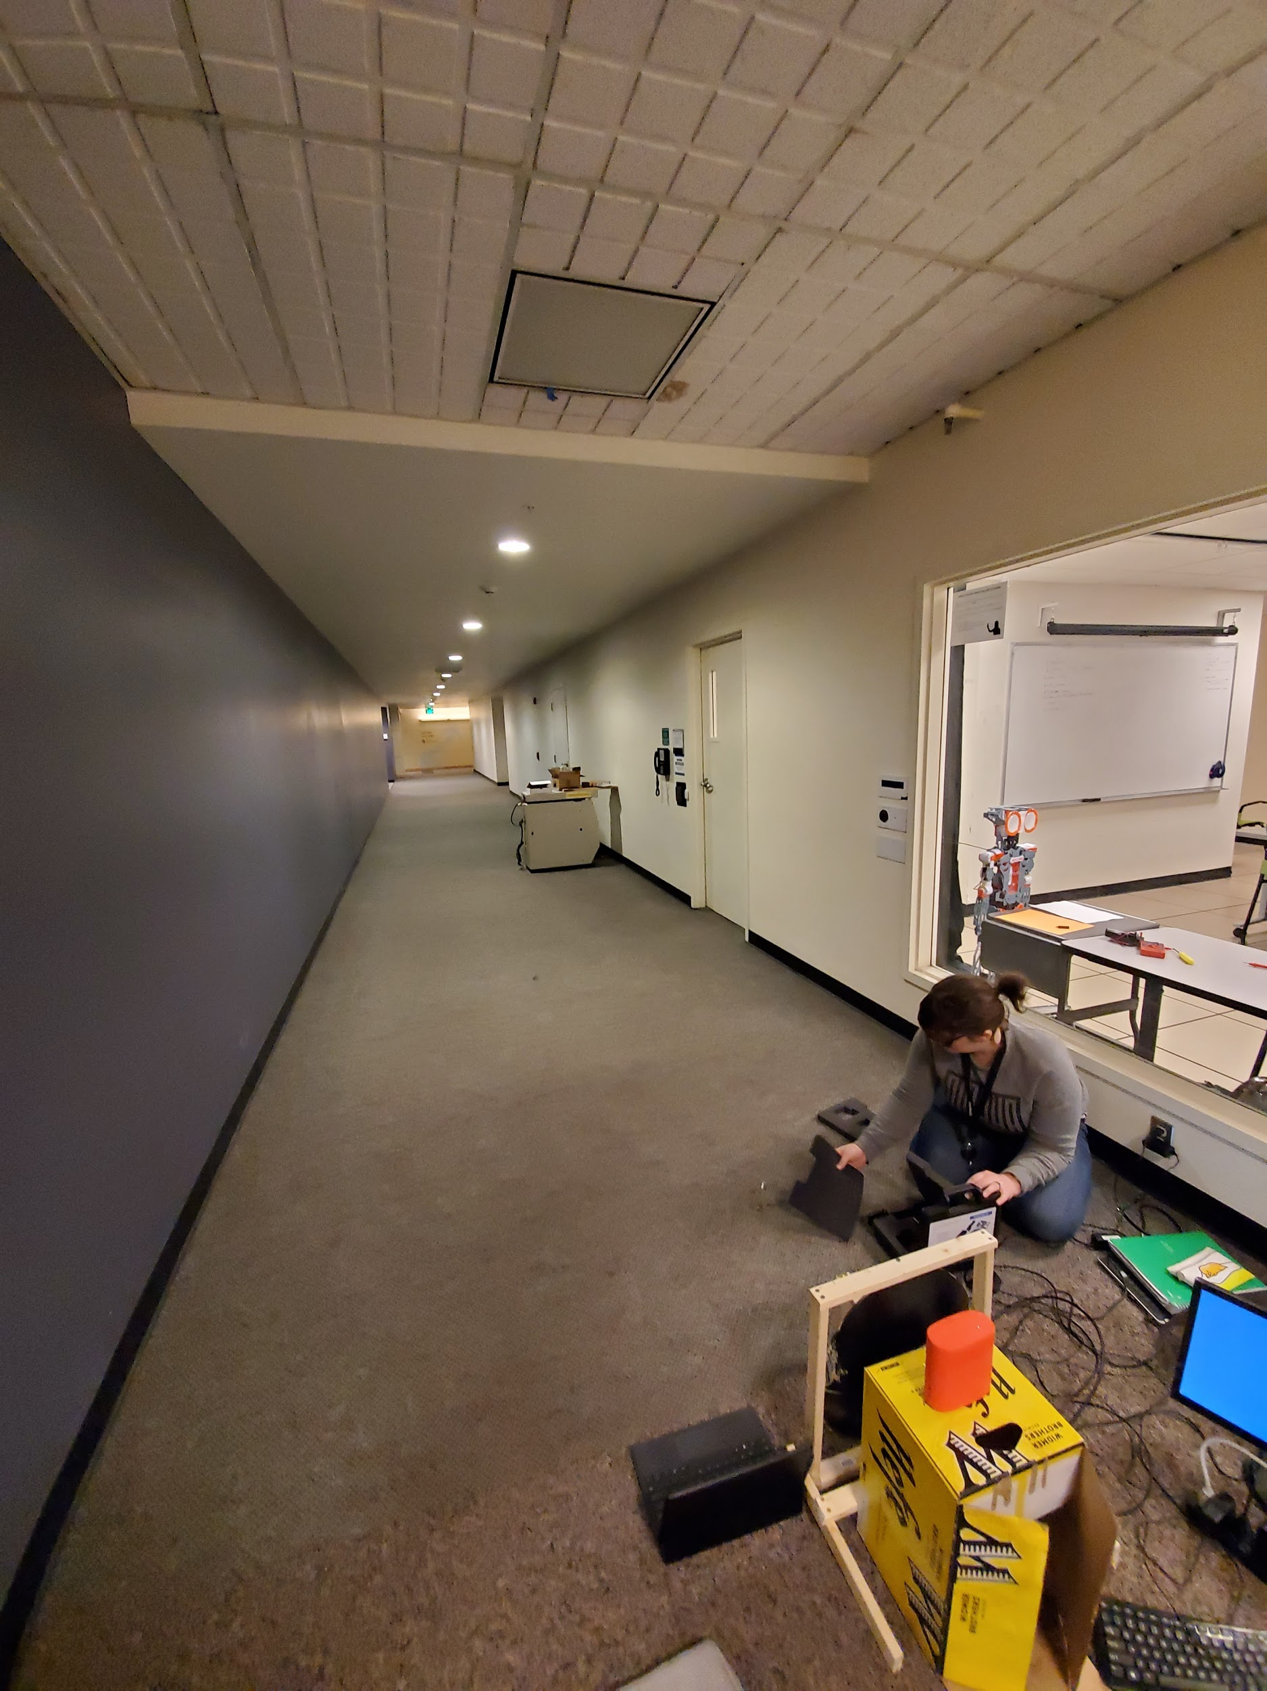
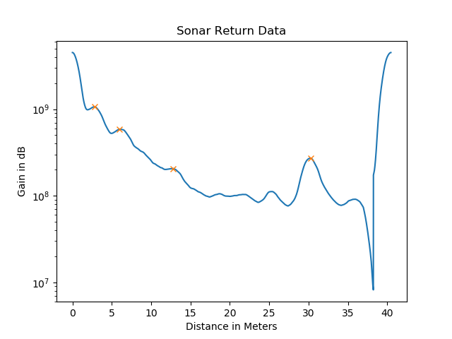
Testing and Results

